Slide 1
Well Come

Slide 2
Identity
Md. Nurul Amin
Computer Teacher
Bhalukghar Azizia Fazil Madrasah.
Keshabpur, Jessore.
Email: namin3958@gmail.com
Class: Six
Sub: English 2nd Paper
Time: 60 Minutes
Date: 07-07-2015
Notes:
alu

Slide 3
Learning Outcome
The student will be able to -
Define of Gender.
Define how many kinds of Gender.
Identify all Gender.
Discuss about Gender and Sex.

Slide 4
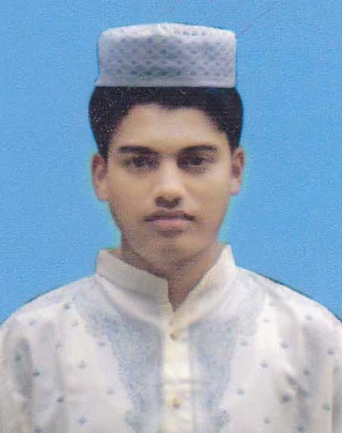
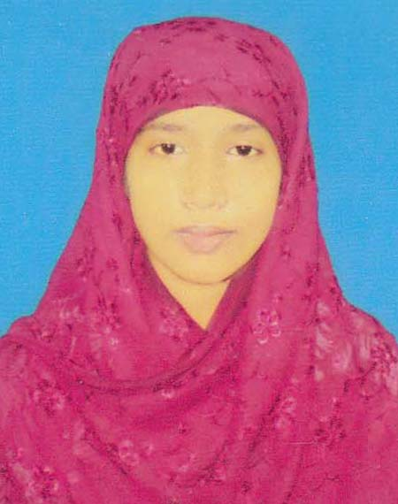
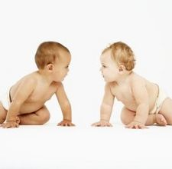
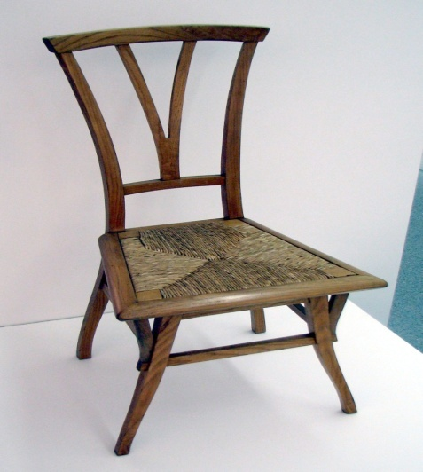
Look at the picture
MAN
WOMAN
CHILD
CHAIR

Slide 5
Today’s Lesson
GENDER

Slide 6
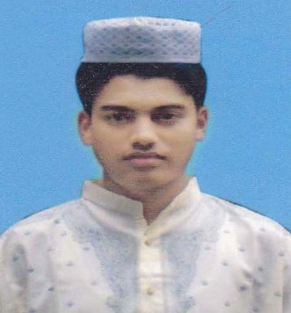
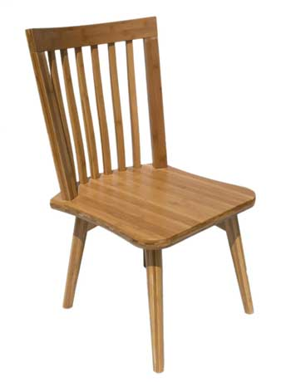
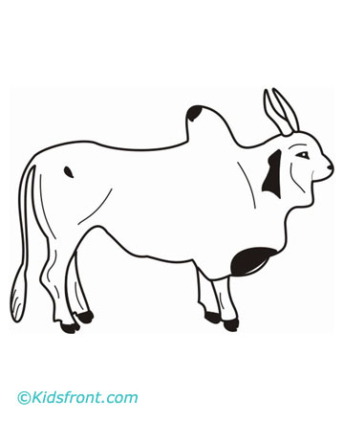
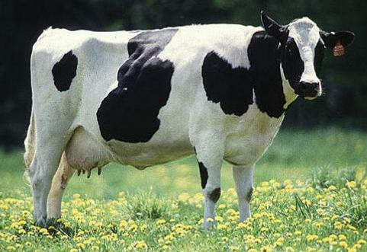
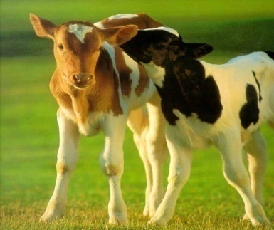
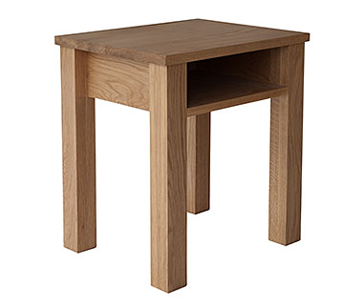
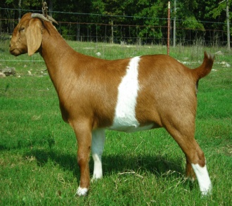
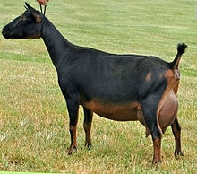
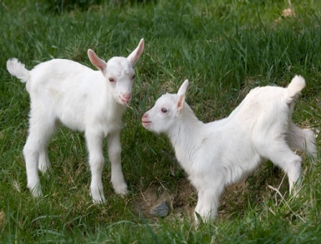
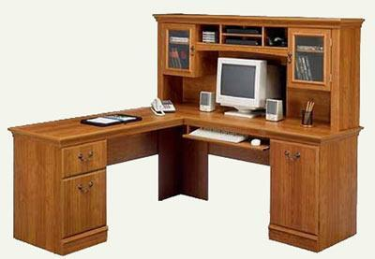
Look at the picture
Masculine Gender
Feminine Gender
Common Gender
Neuter Gender

Slide 7
* What is Gender ?
Gender : When a word denotes a male or female or both
male & female or things without life is called a
Gender.
* How many kinds of Gender ?
Gender
Masculine Gender
Feminine Gender
Common Gender
Neuter Gender

Slide 8
* What is Masculine, Feminine, Common & Neuter Gender ?
Masculine
Feminine
Common
Neuter
Masculine: A noun that denotes a male is called the masculine gender.
Feminine: A noun that denotes a female is called the Feminine gender.
Common: A noun that denotes either a male or female is called the Common gender.
Neuter: A noun that denotes things without life is called the neuter gender.

Slide 9
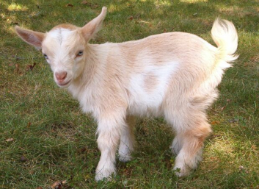
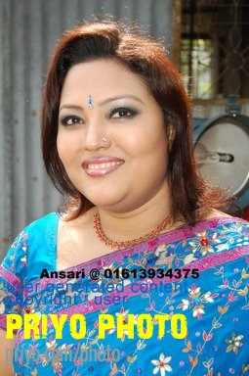
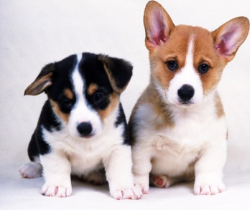
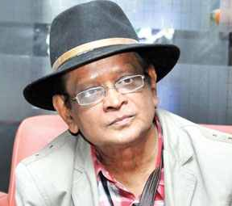
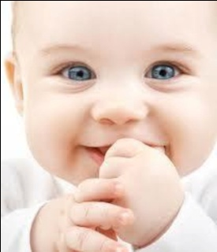
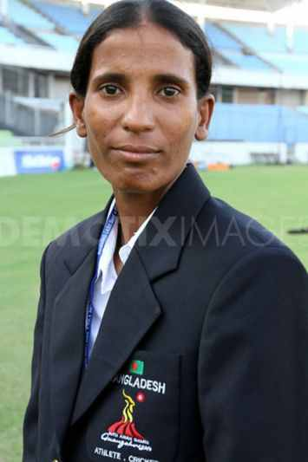
Group Work
Asif Ahmed
Goat kids
Cut
Momtaj Parvin
Afsana mimi
Dog kids
Humayon Ahmed
Chanchol
Sofa set
Child
Dining set
Salma Khatun
Watching these pictures and find out deferent gender.

Slide 10
Evaluation
* What is Gender ?
* How many kinds of Gender ?
* What is Mesculine Gender ?
* Compare the Common & Neuter Gender ?

Slide 11
Home Work
Write down ten example of each Gender.

